Slide 1
CITY COMMENTS & RESPONSES
ORB University
ENGAGE IN A CONVERSATION
ORB UNIVERSITY – APRIL 25, 2023
PRESENTED BY Andres Fernandez, Jose Salazar, Nicole Kimble

Slide 2
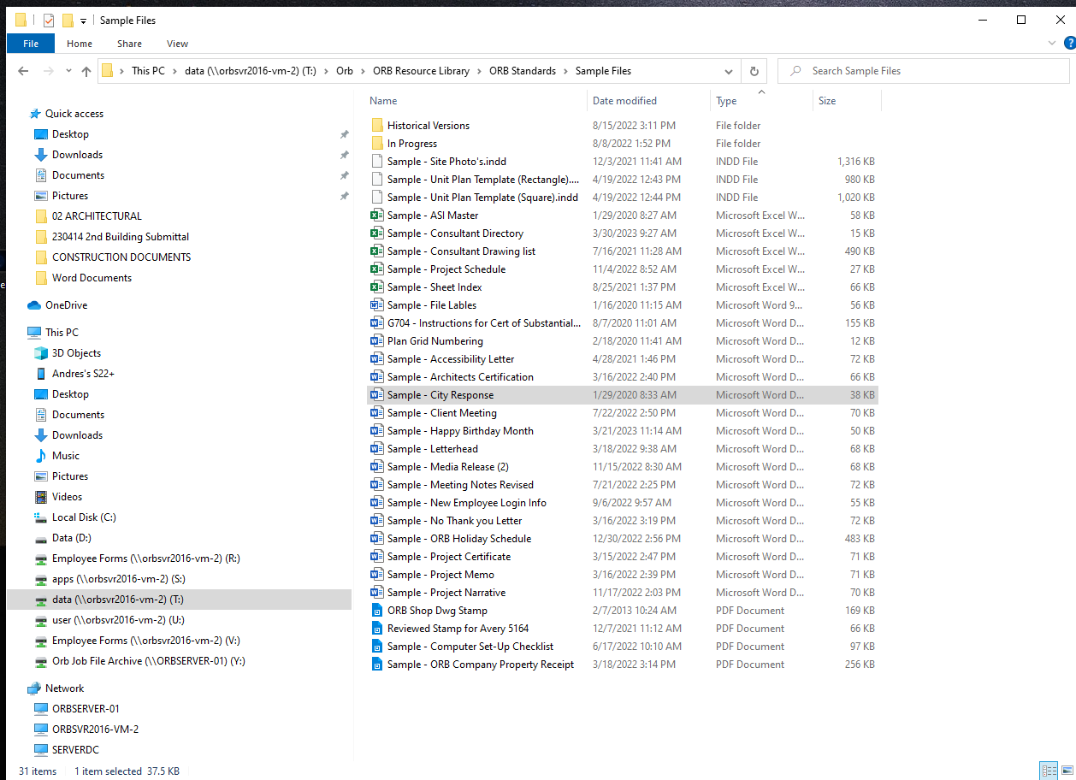
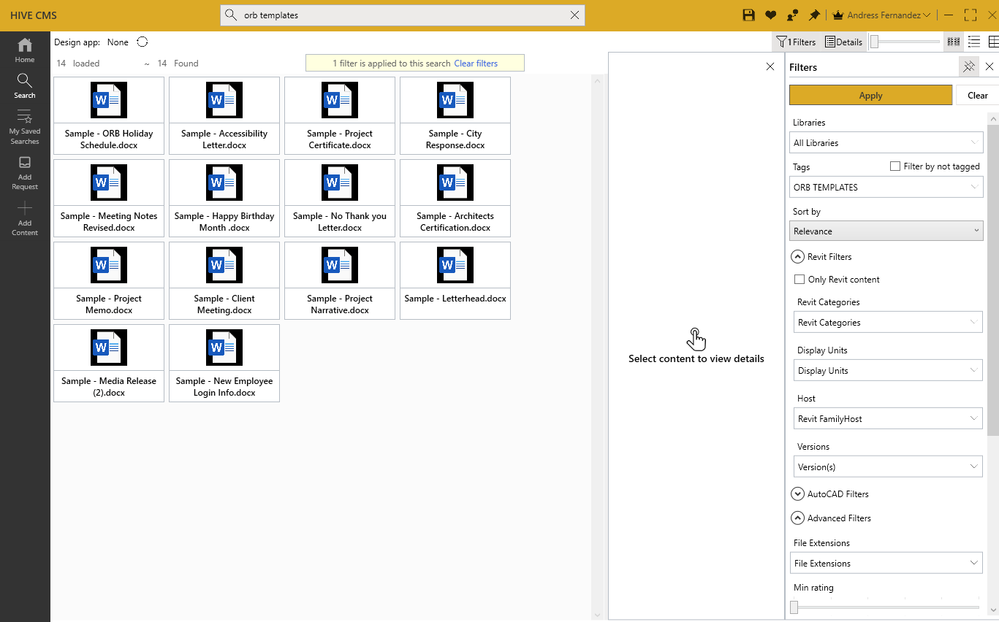
ORB FORMATS / HIVE
Templates are already in place.
Files in HIVE – ORB Templates
T:\Orb\ORB Resource Library\ORB Standards\Sample Files

Slide 3
ORB RESOURCE LIBRARY
ORB has collected submittal information for several municipalities.
Please review the resource library for existing information but always double check the requirements are still relevant

Slide 4
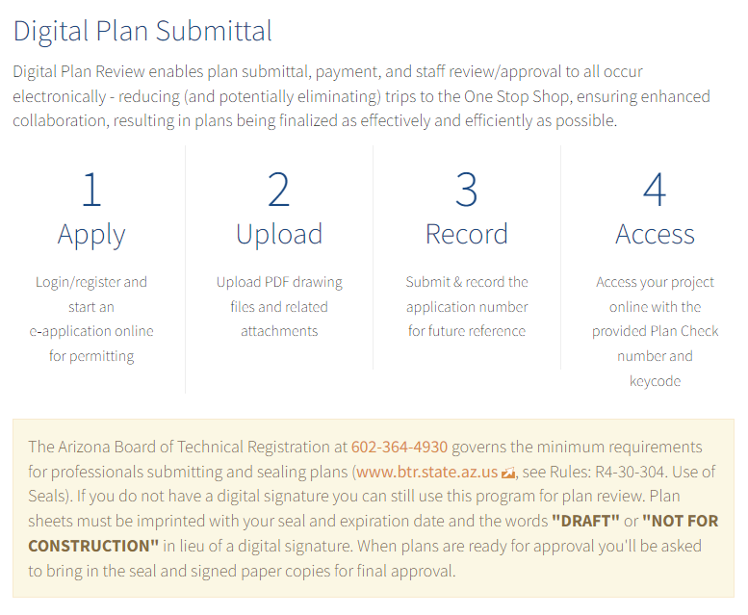
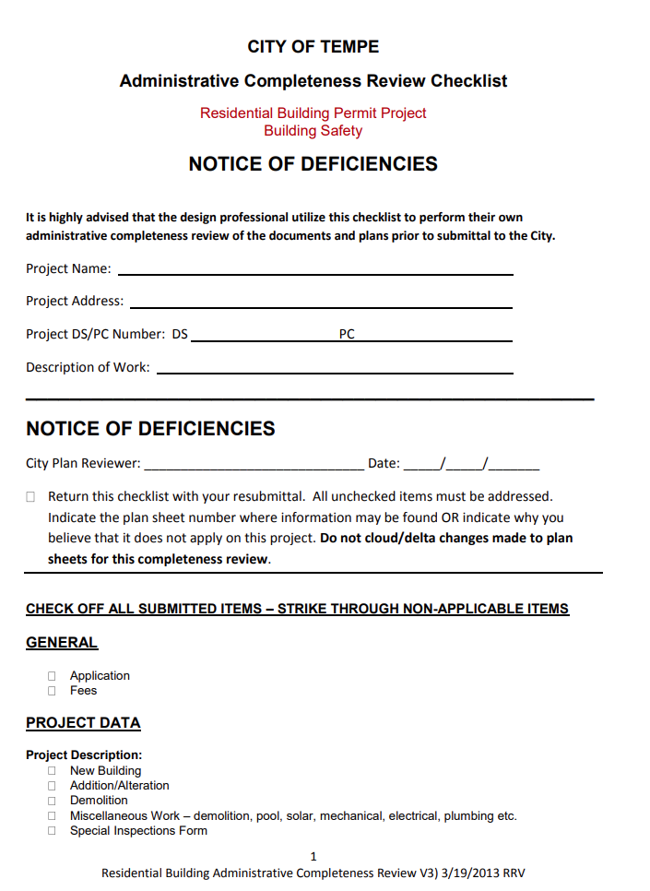
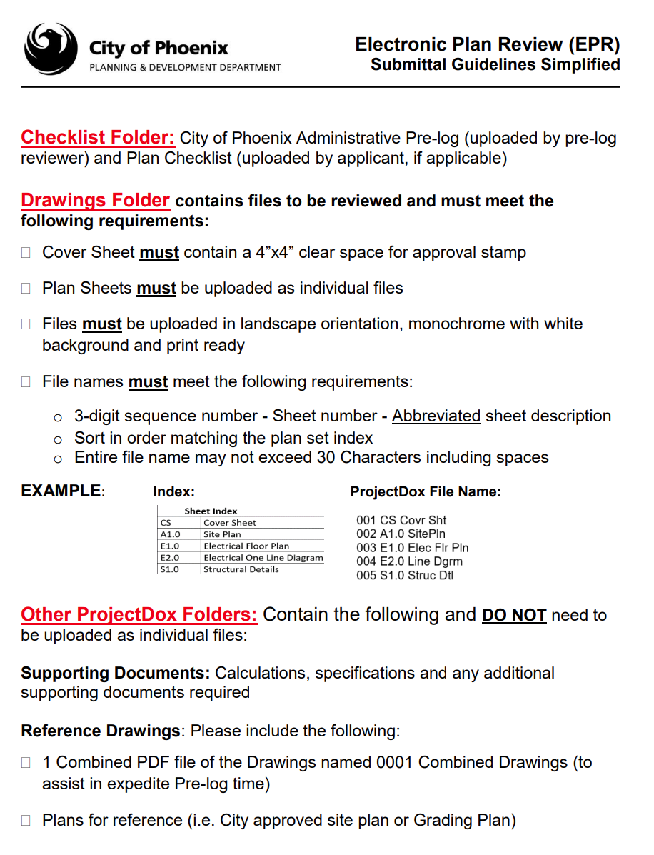
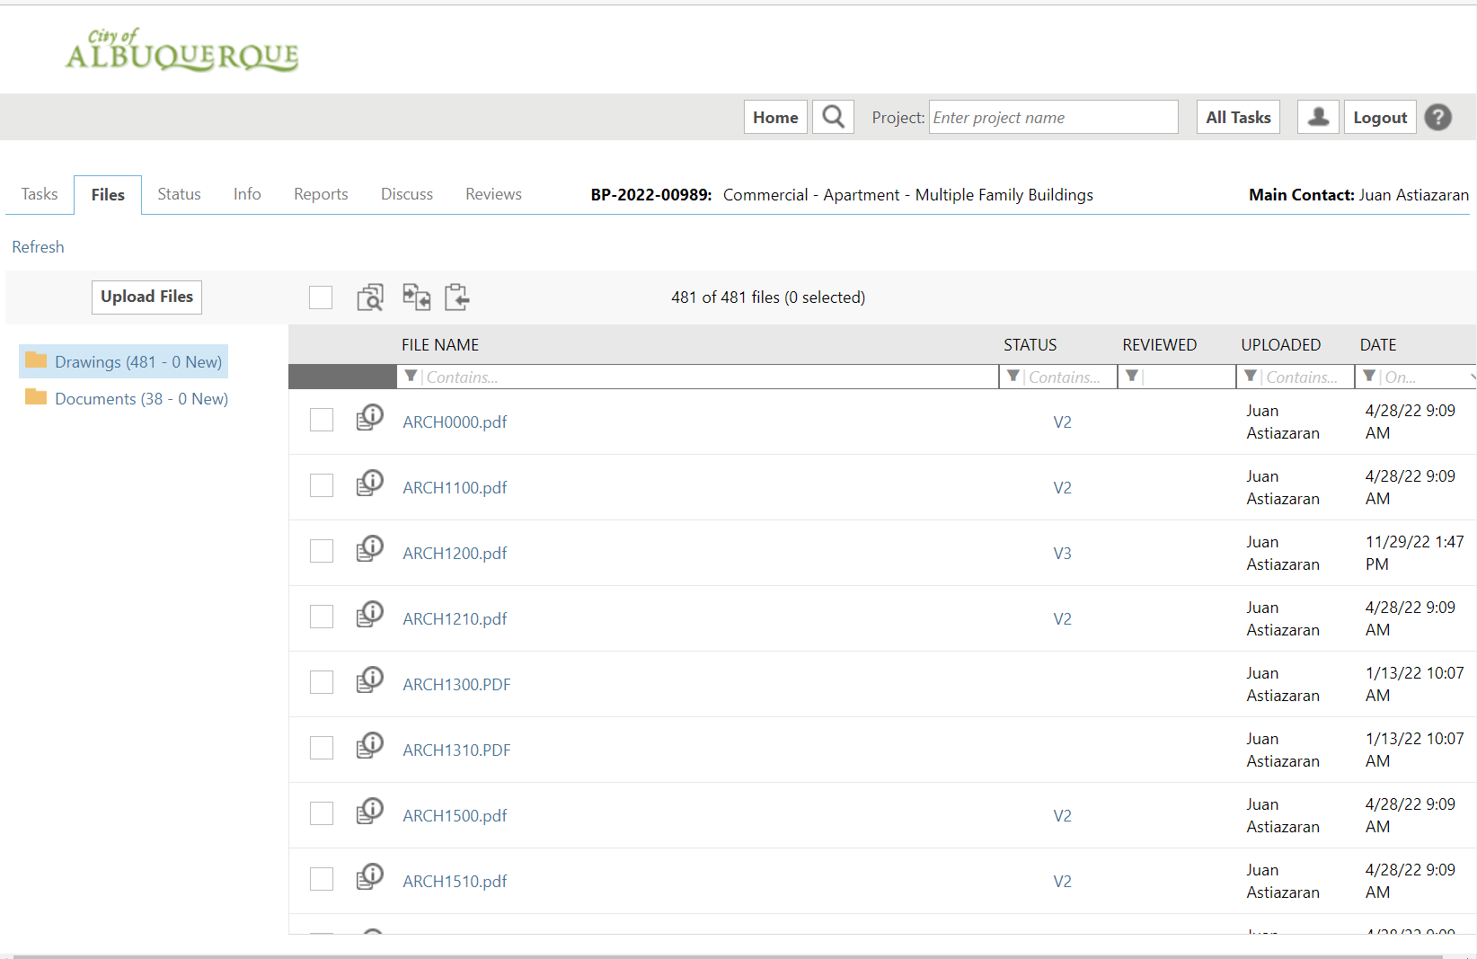
FOLLOW SUBMITTAL DIRECTIONS FROM THE CITY
Every city is different.
Each city has their own requirements for submittal
Do not assume your latest submittal will have the same process
Follow file naming conventions according to each municipality
Confirm if reviewer needs a single file or multiple files
File size limitations can exist when uploading to the cities

Slide 5
FILE NAMING / SHEET NAMING CONVENTIONS
BE SURE TO REVIEW THE SUBMITTAL GUIDELINES.
CITIES MAY TAKE TIME TO DO A PRELIMINARY REVIEW BEFORE BEGINNING THE REVIEW IN EARNEST AND KICK YOU OUT IF THEY FIND SOMETHING IS NOT ACCORDING TO THEIR STANDARDS, COSTING YOU PRECIOUS TIME

Slide 6
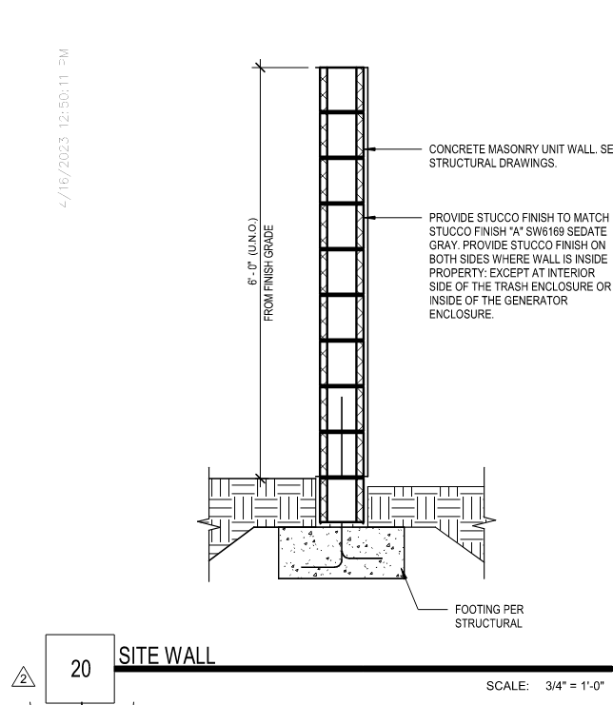
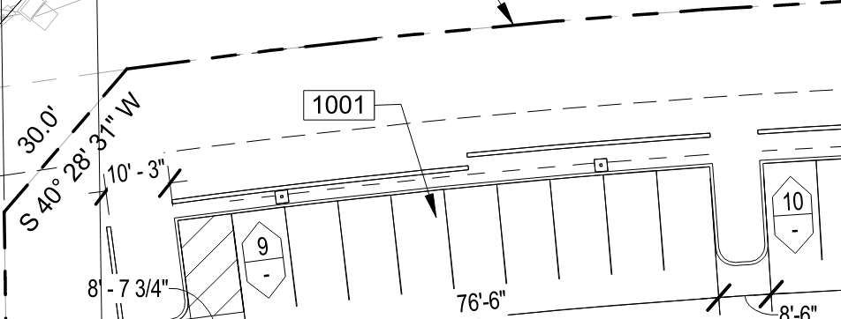
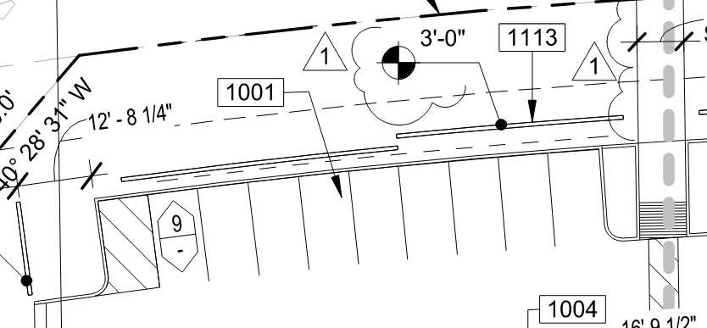
ADDRESS ALL COMMENTS, IN WRITING AND ON THE PLANS
223 | Sheet A1.10 – Site Plan - Perimeter wall? Identify height and provide detail (typ)
223 R | HEIGHTS ARE NOTED ON PLAN

Slide 7
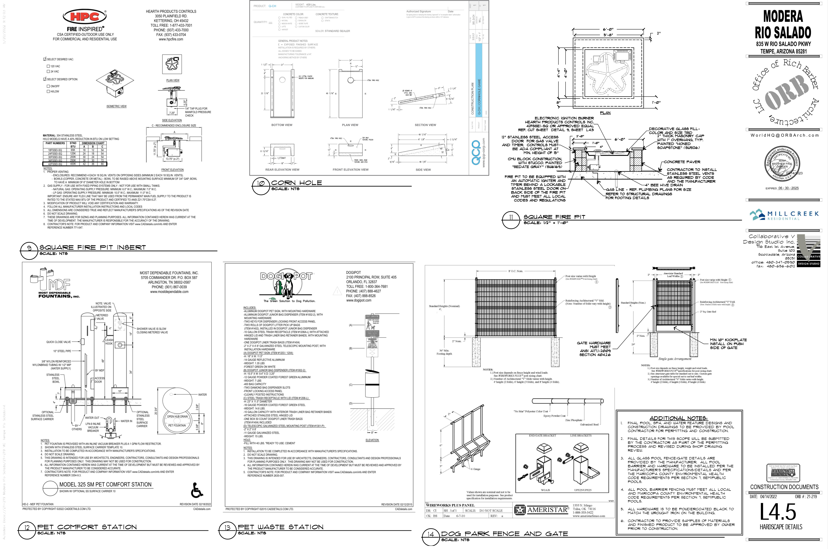
CONFIRM ALL CONSULTANT COMMENTS HAVE BEEN ADDRESSED
WITHOUT THEM SHIFTING THE RESPONSE TO ANOTHER DISCIPLINE.
192 | Sheet P5.5 - Provide manufacturers specifications for all gas fired equipment to be installed with resubmittal documents.
192 R | SEE LANDSCAPE & ARCHITECTURAL PLANS FOR GAS FIRE APPLIANCES SPECIFICATIONS
192 | Sheet P5.5 - Provide manufacturers specifications for all gas fired equipment to be installed with resubmittal documents.
192 R | SEE LANDSCAPE 8/L4.4, 9/L4.5 & 11/L4.9 FOR GAS FIRE APPLIANCE INFORMATION

Slide 8
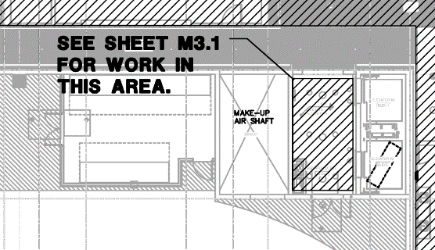
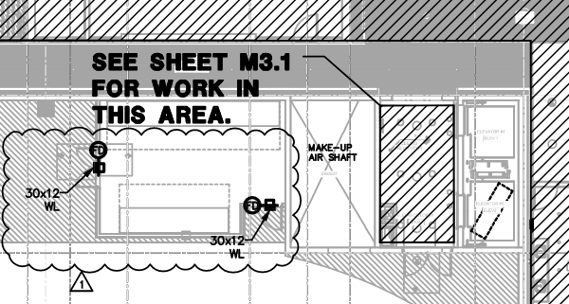
CONFIRM ALL CONSULTANT COMMENTS ARE COORDINATED THROUGHOUT THE SET
192 | Sheet E4.11b & E4.11c - Coordinate with architect requirements for locating SES inside mechanically ventilated parking garage
192 R | SES EQUIPMENT IS NOW PROVIDED IN ENCLOSED SPACE (1 HR RATED ENCLOSURE). SEE REVISED PLANS.

Slide 9
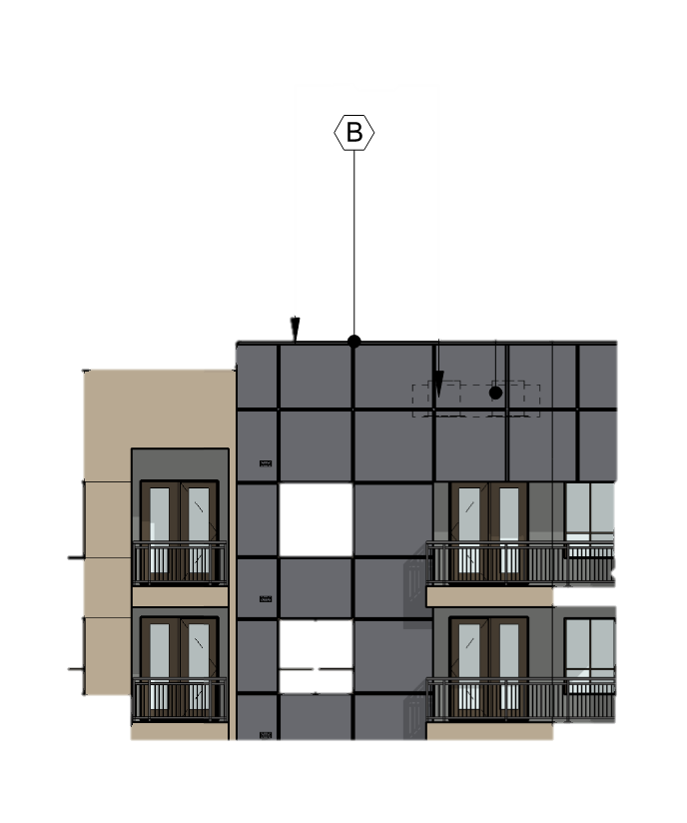
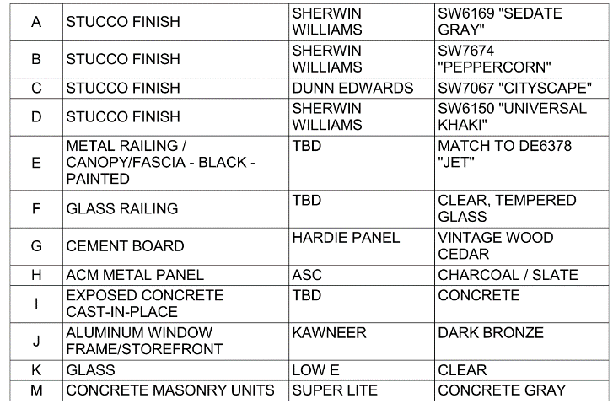
UNDERSTAND WHAT EACH COMMENT REFERS TO
You are very familiar with the drawings, the reviewer is not
253 | Sheet A3.40, A3.42, A3.44.a, A3.44.b, A3.44.c. - Verify "B" finish on north elevation
253 R | THIS IS REFERING TO THE PARAPET STUCCO COLOR.

Slide 10
DO NOT RECITE THE CODE BOOK BACK TO THE REVIEWER
They already know the code. Our job is to let the reviewer know how we are using the code (exceptions, interpretations, commentary, examples, etc.)
67 | Sheet A1.10 - Identify/call out site accessible route – IBC 1104 and identify each accessible entrance – IBC 1105.
67 R | AT LEAST ONE ACCESSIBLE ROUTE WITHIN THE SITE IS BE PROVIDED FROM PUBLIC TRANSPORTATION STOPS, ACCESSIBLE PARKING, ACCESSIBLE PASSENGER LOADING ZONES, AND PUBLIC STREETS OR SIDEWALKS TO THE ACCESSIBLE BUILDING ENTRANCE SERVED. IN ADDITION TO ACCESSIBLE ENTRANCES REQUIRED BY SECTIONS 1105.1.2 THROUGH 1105.1.8, AT LEAST 60 PERCENT OF ALL PUBLIC ENTRANCES ARE ACCESSIBLE.
67 | Sheet A1.10 - Identify/call out site accessible route – IBC 1104 and identify each accessible entrance – IBC 1105.
67 R | ACCESSIBLE ROUTES ARE NOW SHOWN ON SITE PLAN, LEADING TO ALL ACCESSIBLE ENTRANCES

Slide 11
SPELING, and GRAMMER’?
Use spellcheck.
Have someone else in the office read your responses.
Ann can help you not only with spelling, but also formatting.
AVOID ONE-WORD-ANSWERS
Engage in a conversation with the reviewer but keep your answers brief.
Show your reasoning and where they can look to find corroborating information.
Maintain a courteous tone. Always treat them with respect.

Slide 12
Reviewer expanded comment - #1
FP36 | GENERAL: The Fair Housing Act (FHA) is applicable to this project. All units and common areas are covered and are designed to be compliance with the FHA. Section 504 of the Rehabilitation Act which prohibits discrimination on the basis of disability in federally-assisted programs or activities. There is no federal funding on this project (AHJ require to comply with section 504 on a non-federally assisted project)

Slide 13
Reviewer expanded comment - #2 don’t apply
FP36 | Emergency escape and rescue openings shall be provided in the following occupancies: 1. Group R-2 occupancies located in stories with only one exit or access to only one exit as permitted by Tables 1006.3.3(1) and 1006.3.3(2). 2. Group R-3 and R-4 occupancies. Basements and sleeping rooms below the fourth story above grade plane shall have not fewer than one exterior emergency escape and rescue opening in accordance with this section. … Such openings shall: open directly into a public way or to a yard or court that opens to a public way, have min. net clear opening of 5.7 SQ FT, with min. net clear opening height dimension shall be 24”, min. net clear opening width dimension shall be 20”, and shall have the bottom of the clear opening not greater than 44” measured from the floor.
PF36 R | Emergency escape and rescue openings are not required. IBC 1030.1 Exception 4 - Within individual dwelling units in Groups R-2, where the building is equipped with a sprinkler system installed in accordance with Section 903.3.1.1, 903.3.1.2.

Slide 14
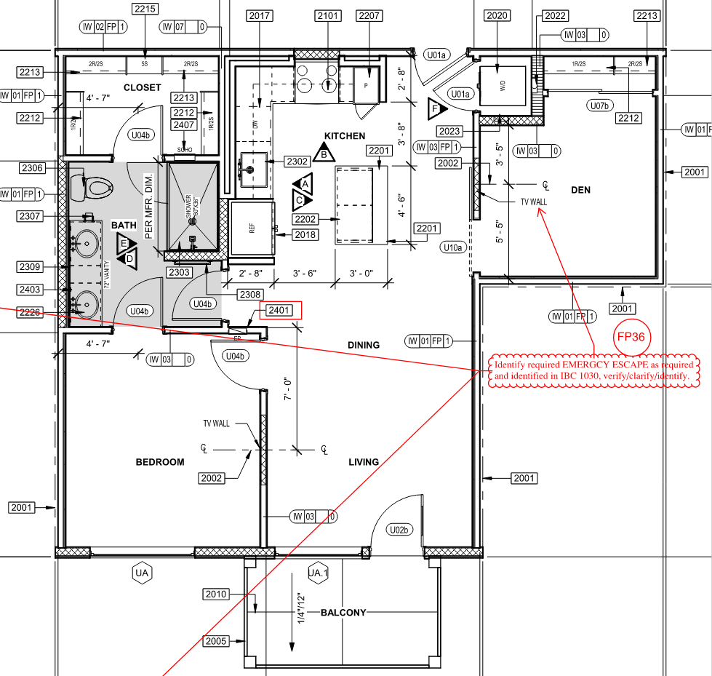

Slide 15
Reviewer’s comment difficult to understand
AD04 | Identify required ACCESSIBLE UNITS, by type, as identified and required by Fair Housing Act Section 504, ACCESSIBLE: =>4 units w/o elevator – ALL, =.4 units w/elevator 5% not <1, 16 or more 5% not <2, VISION/HEARING: 2% MIN. 1, and ICC A117.1 202 and 1101.1.
AD04 R | See General note, above. This is a Section 504 requirement which is not applicable. To comply with code all units shall be Type B units. The design criteria can be found in Section 1104.
 | Town of Gilbert removed Chapter 11, Type A units is a code requirement only and is scoped in Chapter 11. Town of Gilbert removed the scoping requirements of Chapter 11; therefore no Type A units are required.

Slide 16
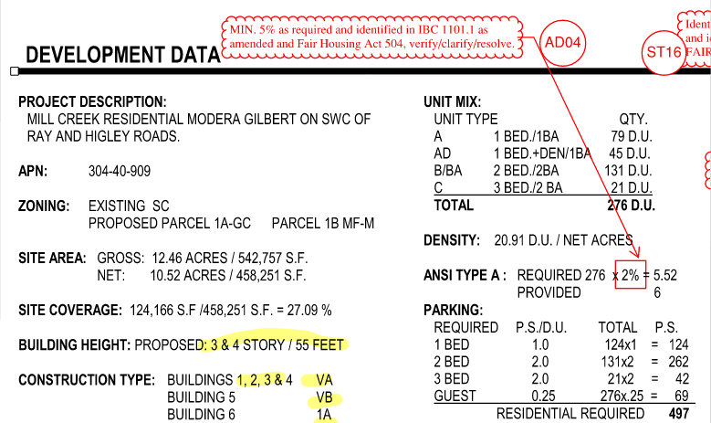

Slide 17
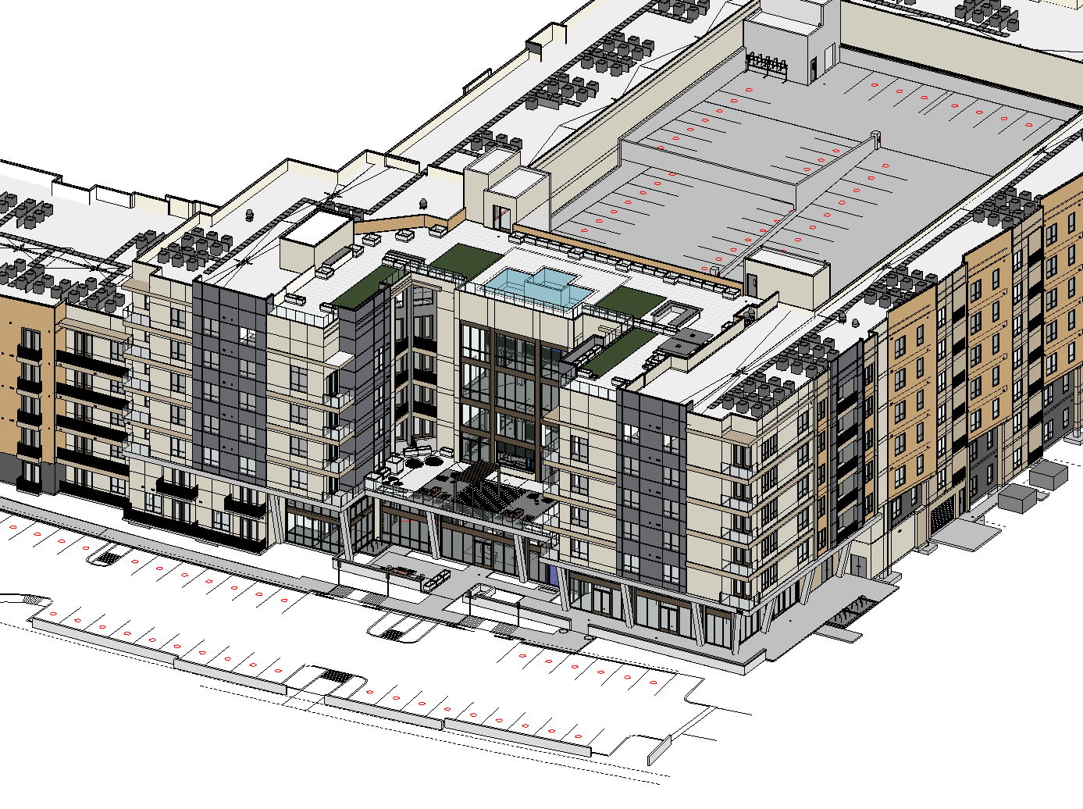
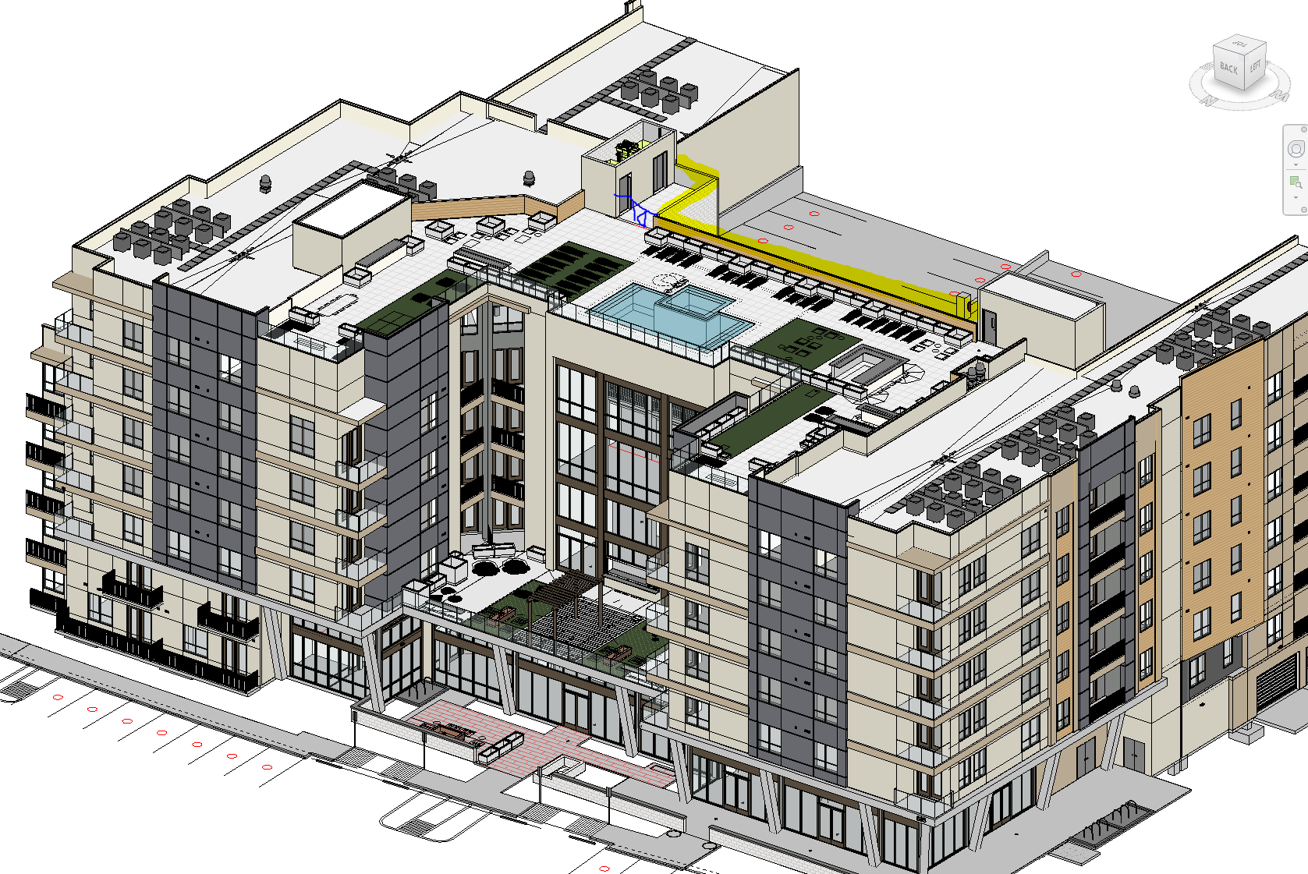
CONTINUE THE CONVERSATION
City reviews are often narrow in their scope. Talk to others in the office and benefit from their experience.
Your current code may not allow you certain things, but it may be allowed under future versions of the code.

Slide 18
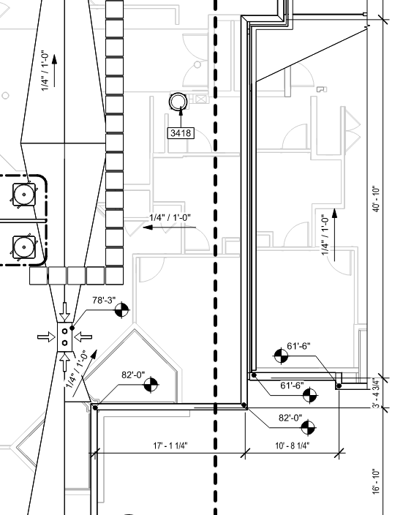
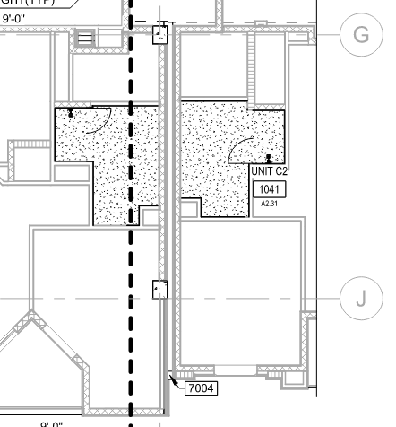
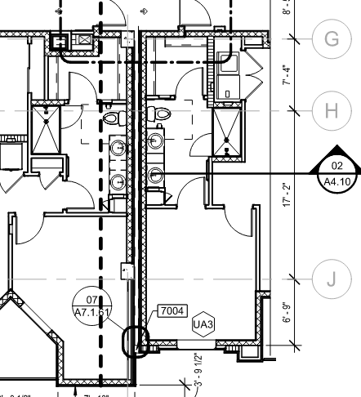
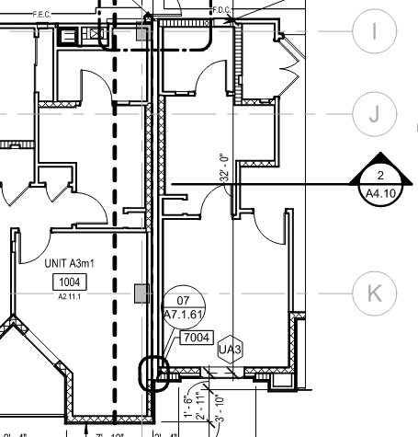
FOLLOW THROUGH ON ALL YOUR CHANGES
Changing plans, model elements or notes in one location will create a ripple effect across all views where that element occurs.
Go back and make sure every plan view, section, elevation and area plans are updated correctly along with your consultant files

